Slide 1

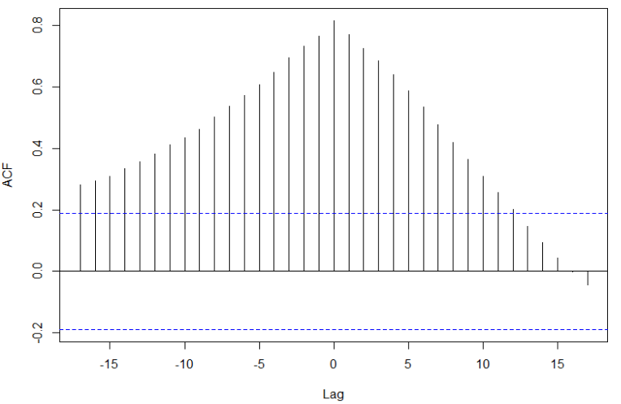

California
MLR Candidate Model
Notes:
Josh Notes: 15 sec
The first thing we noticed about comparing New cases to hospitalizations in California is that there is no apparent lag between the two variables. This is a really important finding as it implicates that we won’t be able to predict imminent changes in hospital bookings resulting later from changes in the rates that new cases are popping up, but rather that those changes happen at the same time.

